Slide 1
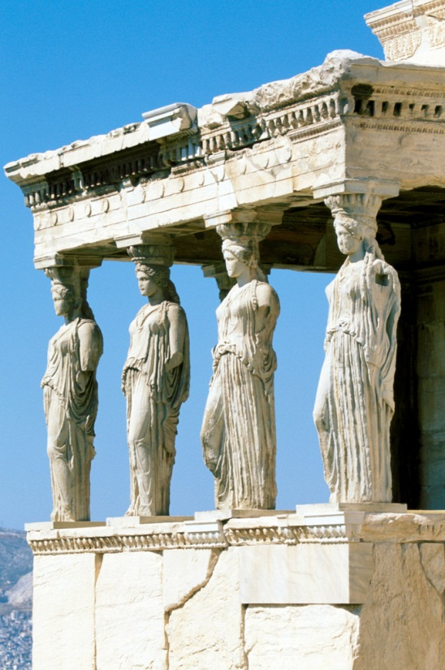
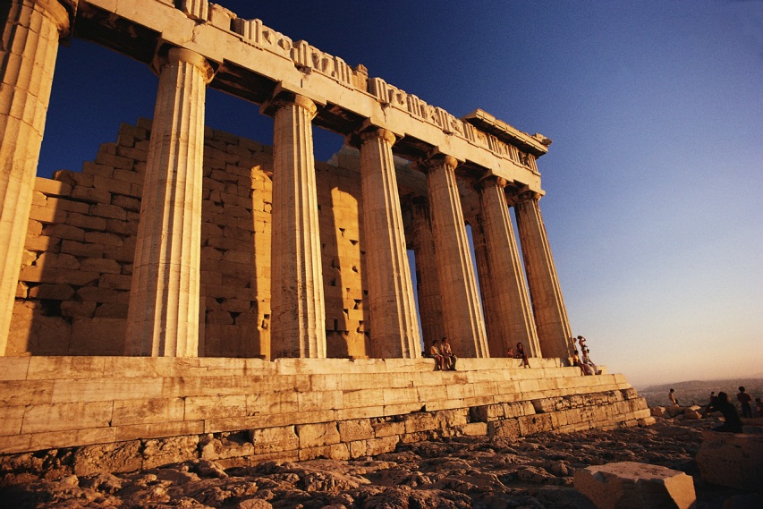
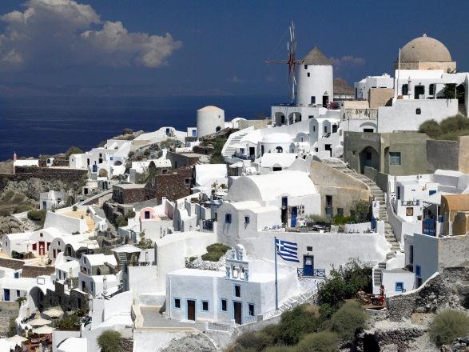
Democracy in
Ancient Athens
The Birthplace of Democracy

Slide 2
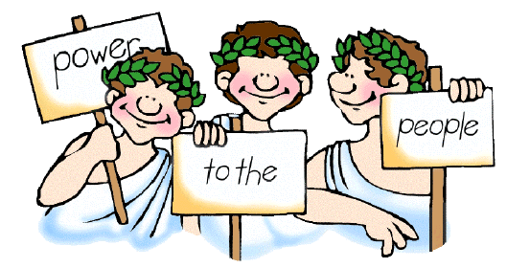
Exactly how Ancient?
The ancient city of Athens refers
to a time more than 2500 years ago.

Slide 3
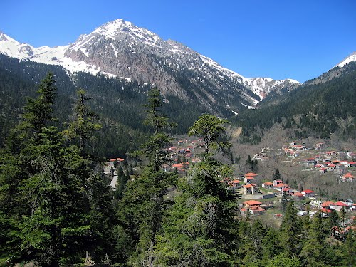
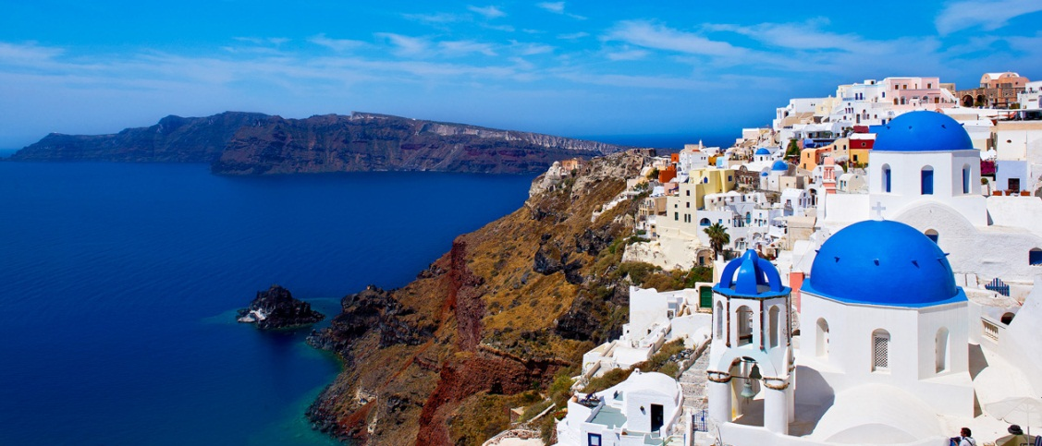
Who were the Ancient Athenians?
Greece is a mountainous country.
As a result, communities were isolated from one another by the rugged landscape.
Because of this isolation, each ancient Greek city developed its own style of government, its own laws, and built up its own army.
These independent communities are known as city-states.

Slide 4
Who were the Ancient Athenians?
Some of the city-states were controlled by rich and powerful rulers called tyrants.
Tyrants are rulers who seize power and govern in a harsh cruel way.
The Athenians were different by developing a system of government that allowed citizens to participate in making important decisions.
Other city-states eventually followed suit at a later time.

Slide 5
Athenian Social Structure
Citizens
Metics
Slaves

Slide 6
Citizens
Children of parents who were born in Athens.
Only male citizens could participate in voting and governing the city.
Men became citizens when they finished military service at age 20.
Women could not participate at all.

Slide 7
Metics
Residents of Athens born outside the city-state.
Not allowed to own land or become citizens.

Slide 8
Slaves
Owned privately or by the city-state.
Many slaves were people who had been taken prisoner when their city-state was attacked by the Athenians.
Slaves could not become citizens.

Slide 9
THINK, PAIR, SHARE

Slide 10
Lets Discuss…
Take 30 seconds to consider the following question:
Do you feel men and women have similar or different roles in Canadian Society today? Support your answer with evidence.

Slide 11
What were the Roles of Men and Women in Athens?
In your Duotangs, split a sheet of paper in half and label one side females, and the other males.
Read Pages 59-60 and record the roles and responsibilities of each in the appropriate column. (10 minutes)
Then, mingle with each other and share your ideas. Did you miss anything? If so, be sure to make note of it.

Slide 12
Canadians believe democracy is the fair and equal treatment of all people. Is this the same for the Athenians?
Lets take a look!

Slide 13
Athenian Democracy
Citizens are allowed to rule themselves.
Majority rule was fair. (A decision was supported by more than half of the votes)
Only male citizens had the right to belong to the Assembly and vote.
Women, slaves, and metics were denied voting rights.
Slavery was perfectly acceptable in Athenian Society.
The Common Good was the most important thing. Individual and minority rights were of no importance.

Slide 14
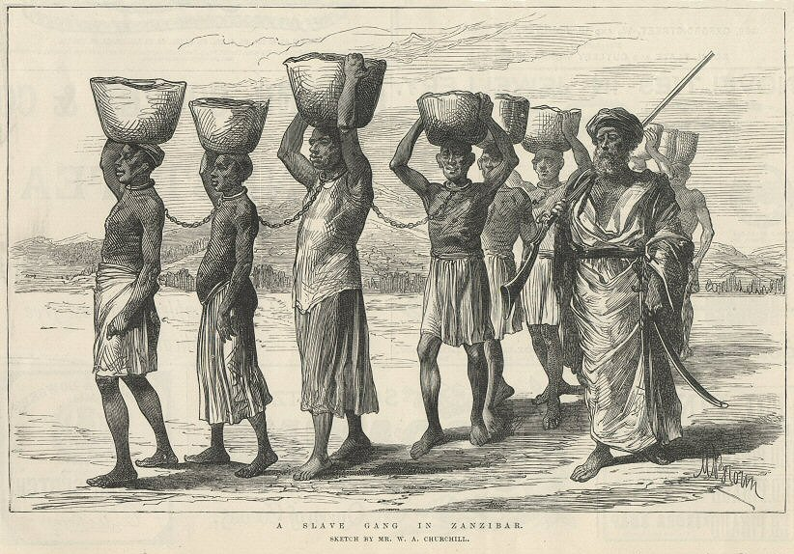
Take a look at “More About…Slavery and Democracy” on Page 61. Do you agree? Why or Why not?

Slide 15
How were Athenian Citizens Involved in Decision Making?
Athenian Democracy
The Assembly
The Council of 500
The Court

Slide 16
Your task…
Create a Map showing the three pillars of Athenian Democracy. For each pillar, describe the responsibilities and characteristics.
Pages 64-65, 67-68

